Slide 1
Instagram User Analysis
Pushkar Raj
Start Presentation
**********

Slide 2





PRESENTED BY:-
Pushkar raj

Slide 3


PROJECT OVERVIEW
Instagram User Analysis
Approach
Tech stack
Insights
Results
Instagram_user_Analysis
The aim of this project is to analyze Instagram user data to provide valuable insights that will be used by both the product and marketing teams to make informed decisions that help to grow the business.
As a data analyst working with the product team at Instagram, my role is to analyze various aspects of user interactions and engagement to help the company.
1 likes

Slide 4
PURPOSE
Instagram User Analysis
Approach
Tech stack
Insights
Results
Instagram_user_Analysis
The primary purpose of this project is to use SQL and MySQL Workbench to provide useful insights from Instagram's user data which has been crucial in finding patterns and trends that affect Instagram’s growth and user engagement….
2 likes

Slide 5

Approach
Instagram User Analysis
Tech stack
Insights
Results
Approach to handle task
and drive Insights
First, it is necessary to become familiar with Instagram‘s user database schema, understanding where and how to extract the necessary data for each task.
I will write SQL queries for each task that quickly and accurately retrieve the needed data from the database.
For analysis and validation run the SQL queries in MySQL Workbench and examine the results to find useful insights.
Now, with the help of the analyzed data that generates the required insights, business decisions can be made.
3 likes

Slide 6
Approach
Instagram User Analysis
Tech stack
Insights
Results
Approach to the project
I will write SQL queries for each task that quickly and accurately retrieve the needed data from the database.
Schema understanding is necessary to understand the tables, relationships, columns, and constraints within the database.
SQL queries were written to efficiently and accurately retrieve data from the database to identify loyal users, find inactive users, and determine the most popular hashtags
These queries were run in MySQL Workbench to get accurate and timely results.
4 likes

Slide 7
Approach
Instagram User Analysis
Tech stack
Insights
Results
Approach to the project
This step involves the analysis process in which queries are executed and results are examined to extract meaningful insights that help to address the management's questions. After this, validation occurs to ensure accuracy and consistency, which involves understanding the data to effectively respond to management’s questions
The data is analyzed to produce valuable insights that can be used by different teams within the business to make decisions, such as launching new campaigns, developing new features, or improving user experience
I put together the result in a clear report with the SQL queries used, and a detailed explanation of the insights
4 likes

Slide 8



TECH-STACK USED
Instagram User Analysis
Approach
Insights
Results
Software used: MySQL workbench(version 8.0)
REASON
1
It has a simple interface that is suitable for quickly writing, testing, and executing SQL queries.
It provides number of tools needed for database design, writing queries, and managing the database in one place.
To understand the data and derive insights, MySQL Workbench allow to visualize query results, see how tables relate to each other, and view the overall database structure.
It's designed to work perfectly with MySQL Server, so there are fewer compatibility issues.
2
3
4
5 likes

Slide 9

INSIGHTS
Instagram User Analysis
Approach
Tech stack
Results
Project Insights and Knowledge
Marketing Analysis
It has a simple interface that is suitable for quickly writing, testing, and executing SQL queries.
Found users who have never posted photos in order to encourage them to start posting by sending them promotional emails.
Determined the winner of a contest based on the highest number of likes on a single photo. This insight can help in planning future contests or campaigns that boost user engagement.
Identified the most popular hashtags used by users on the platform to help the partner company reach the most people.
Analyzed trends when users sign up the most to find the best days for running ad campaigns.
6 likes

Slide 10
INSIGHTS
Instagram User Analysis
Approach
Tech stack
Results
Project Insights and Knowledge
Investor Metrics
Identified the users who have been using Instagram for the longest time.
Found users who liked every photo, which might mean they're bots, and flagged them for review to keep the platform high-quality.
Calculated how many photos there are per user to see if the amount of content is balanced with the number of users.
The insights gained from analyzing user data can directly influence the future development of the Instagram app.
6 likes

Slide 11
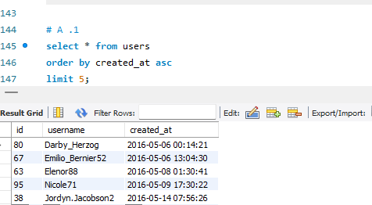
INFERENCES AND FINDINGS
Instagram User Analysis
Approach
Tech stack
Results
Loyal user reward
The five oldest users who have been using Instagram for the longest time
These users could be ideal candidates for receiving exclusive rewards
Certain features or user experiences may encourage long-term engagement
7 likes

Slide 12
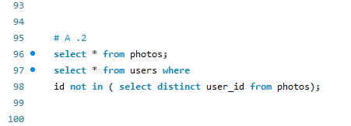
INFERENCES AND FINDINGS
Instagram User Analysis
Approach
Tech stack
Results
Inactive user Engagement
Queries to detect the users who have been never posted a single photo on instagram
7 likes

Slide 13
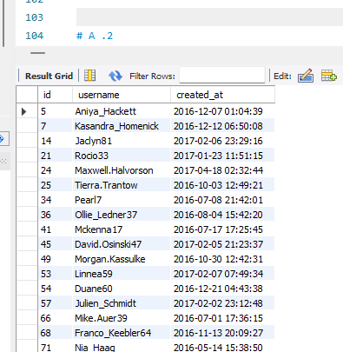
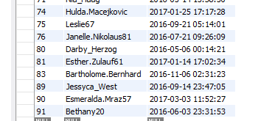
INFERENCES AND FINDINGS
Instagram User Analysis
Approach
Tech stack
Results
Inactive user Engagement
A notable number of users have never posted a photo on Instagram
ENCOURAGE TO POST
1
Sending Promotional Emails
2
new feature incentives
3
Market Campaign
7 likes

Slide 14
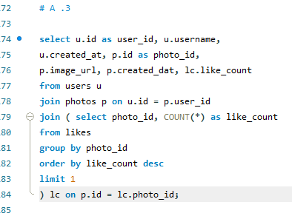
INFERENCES AND FINDINGS
Instagram User Analysis
Approach
Tech stack
Results
Contest Winner Declaration
Photo
CONTEST WINNER
Most Liked Photo
8 likes

Slide 15
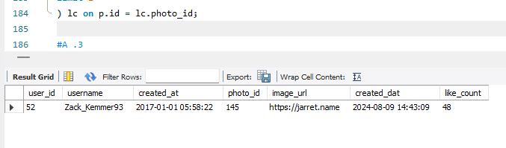
INFERENCES AND FINDINGS
Instagram User Analysis
Approach
Tech stack
Results
Contest Winner Declaration
Contest Winner
Leveraging his popularity to promote instagram feature
Most likes on
single photos
High engagement with Platform
8 likes

Slide 16
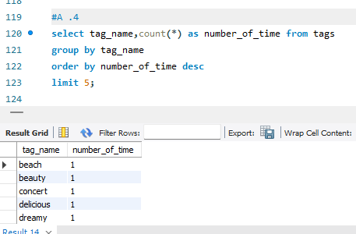
INFERENCES AND FINDINGS
Instagram User Analysis
Approach
Tech stack
Results
Popular Hashtags
The top five most commonly used Hashtags
Guide Partner brand on where to focus their content strategies to maximize reach
9 likes

Slide 17
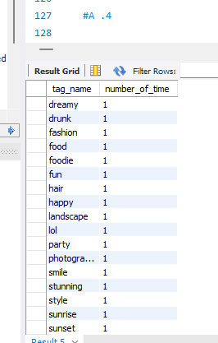
INFERENCES AND FINDINGS
Instagram User Analysis
Approach
Tech stack
Results
Popular Hashtags
Other Hashtags that are used just as frequently
Hashtags highlight popular theme or topic in instagram
9 likes

Slide 18
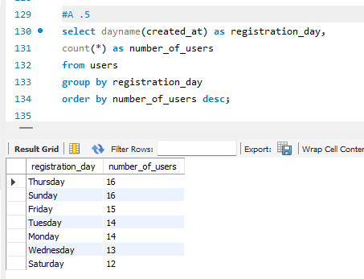
INFERENCES AND FINDINGS
Instagram User Analysis
Approach
Tech stack
Results
Ad campaign timing
The Day with highest number of users registration
Query to derive the best day for ad campaign from the data
10 likes

Slide 19
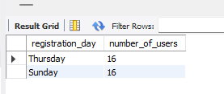
INFERENCES AND FINDINGS
Instagram User Analysis
Approach
Tech stack
Results
Ad campaign timing
Worst Day for Ad Campaign
REGISTRATION DAYS
Mon | Tue | Wed | Thu | Fri | Sat | Sun
Best Days for Ad Campaign
10 likes

Slide 20
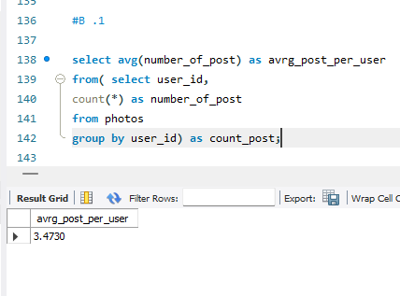
INFERENCES AND FINDINGS
Instagram User Analysis
Approach
Tech stack
Results
User engagement metrics
The average number of posts per user
3.4730
The average is moderate
Necessary to introduce features that encourage more frequent posting
Provides a benchmark for typical user engagement
11 likes

Slide 21
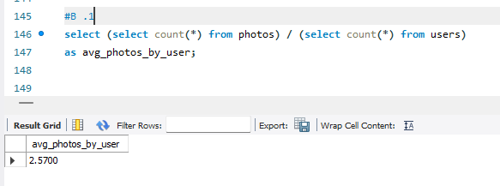
INFERENCES AND FINDINGS
Instagram User Analysis
Approach
Tech stack
Results
User engagement metrics
Average number of Photos per user
2.5700
Helps to know how much content is on the platform
11 likes

Slide 22
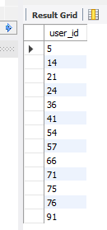
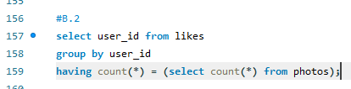
INFERENCES AND FINDINGS
Instagram User Analysis
Approach
Tech stack
Results
Bots and Fake Accounts
1
Users who liked every single photo on the platform
2
These accounts counts could distort engagement
3
Decrease the experience for genuine users
4
These accounts need to be maintain the platform’s integrity
QUARY
BOTS AND FAKE ACCOUNTS
12 likes

Slide 23


RESULTS
Instagram User Analysis
Approach
Tech stack
Insights
Results
Achievements_
Achievements accomplished from the project
01
ENHANCED DATA ANALYSIS SKILLS
By working with large datasets and using SQL to extract meaningful insights, I improved my ability to analyze user data effectively
02
ANALYSIS OF USER BEHAVIOR
The project offered crucial understanding of user behavior patterns, including recognizing loyal users, addressing inactivity, and identifying content engagement trends. This information aids in developing more precise and impactful marketing and product strategies
03
DETECTION OF FAKE ACCOUNTS
Finding users who might be bots showed where the platform can enhance security and user experience by removing or limiting fake accounts
04
EXPERIENCE INVESTOR MATRICS
Calculating metrics that matter to investors, like average posts per user and overall engagement, has given me experience in preparing data that supports business growth
13 likes

Slide 24
RESULTS
Instagram User Analysis
Approach
Tech stack
Insights
Results
_Benefits_
Applied theoretical knowledge in a real-world setting, demonstrating the value of data analysis in shaping business strategies and decisions.
It taught me how to translate data into actionable insights that align with business goals.
1
2
Benefites from the project
It provide the valuable Insights for Business Growth by provided the Instagram team with crucial information to improve user engagement, optimize marketing campaigns, and detect potentially harmful activity on the platform. These insights have a significant impact on the future development and success of the app
Improved skills in writing SQL queries to get useful insights from user and engagement data
4
3
14 likes

Slide 25

RESULTS
Instagram User Analysis
Approach
Tech stack
Insights
Results
_Impact_
Impact of the Analysis
The analysis from this project has been crucial in finding patterns and trends that affect Instagram’s growth and user engagement. By understanding user behaviors and preferences, the insights can help develop new features, improve marketing, and increase user satisfaction. This project shows how data analysis can shape a product’s future and support decisions with strong evidence.
15 likes

Slide 26
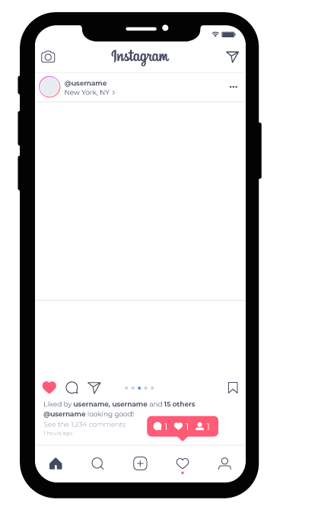
Instagram User Analysis
Approach
Tech stack
Insights
Results
Thanks
16 likes

